Slide 1
Rebuilding Plan Scenarios for Striped Marlin in the WCNPO
ISC Billfish Working Group
Jon Brodziak
Jon.Brodziak@NOAA.GOV
22-April-2024
Notes:
Update on

Slide 2
Open Science for BILLWG
This presentation is on BILLWG google drive at: https://drive.google.com/drive/folders/1vNBZWGnTDX9_wl-RByhKqA40jsHUOJCy
To access results, download GitHub repository
https://github.com/PIFSCstockassessments/2024-WCNPO-MLS-Rebuilding
Base case projection input files (3-recruitment models with 2-year out-of-sample weights) are in ~/2024 Results/base-runs
Medium-term recruitment model results are in ~/2024 Results/medium-term-runs
Short-term recruitment model results are in ~/2024 Results/short-term-runs
Long-term recruitment model results are in ~/2024 Results/long-term-runs

Slide 3
Introduction

Slide 4
Rebuilding Target

Slide 5
Fishing Mortality

Slide 6
Initial Population Numbers at Age

Slide 7
Bootstrap Distribution of Initial Population Size

Slide 8
Stock-Recruitment Relationship from 2023 Assessment

Slide 9
Average Recruitment for Short and Medium Term Models

Slide 10
ECDFs of Recruitment for Short- and Medium-Term Models

Slide 11
Time Trends in Recruitment

Slide 12
Change Point in 1993 for Recruitment Series
CP=1993

Slide 13
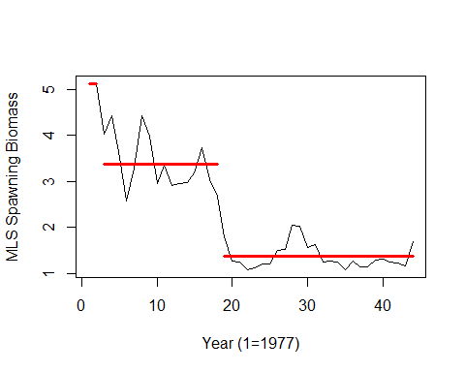
Change Point in 1995 for Spawning Stock Biomass Series
CP₂=1995

Slide 14
Sequence of 5-Year Moving Averages of Recruitment

Slide 15
Sequence of 20-Year Moving Averages of Recruitment

Slide 16
Recruitment Residuals of Medium-Term Model

Slide 17
Recruitment Residuals of Short-Term Model

Slide 18
Recruitment Residuals of Long-Term, or SRR Model

Slide 19
Squared Prediction Error by Recruitment Model

Slide 20
Annual Inverse Error-Variance Weights by Recruitment Model

Slide 21
Annual Inverse Error-Variance Weights by Recruitment Model

Slide 22
Annual Inverse Error-Variance Weights by Recruitment Model

Slide 23
Inverse Error-Variance Weights by Recruitment Model Based on 2020 and 2021 Recruitment Prediction Errors

Slide 24
Aggregate Fleet Mean Weights at Age by Assessment

Slide 25
Maturity at Age Ogives by Assessment

Slide 26
Aggregate Fleet Selectivities at Age by Assessment

Slide 27
Aggregate Fleet Yield Per Recruit by Assessment

Slide 28
Aggregate Fleet Spawning Biomass Per Recruit by Assessment

Slide 29
Aggregate Fleet Mean Generation Time by Assessment

Slide 30
Aggregate Fleet Spawning Potential Ratio by Assessment

Slide 31
9-Selectivity Fleet Groups from the 2023 Assessment

Slide 32
Domed Selectivity Fleet Groups from the 2023 Assessment

Slide 33
Flat-Topped Selectivity Fleet Groups from the 2023 Assessment

Slide 34
Proportion of Fishing Mortality by Domed Selectivity Fleet Group

Slide 35
Proportion of Fishing Mortality by Flat-Topped Selectivity Fleet Group

Slide 36
Proportion of Fishing Mortality by Fleet Group

Slide 37
Mean Catch Weights at Age by Domed Selectivity Fleet Group

Slide 38
Mean Catch Weights at Age by Flat-Topped Selectivity Fleet Group

Slide 39
Annual Catch Biomass by Domed Selectivity Fleet Group

Slide 40
Annual Catch Biomass by Flat-Topped Selectivity Fleet Group

Slide 41
Proportion of Annual Catch Biomass by Domed Selectivity Fleet Group

Slide 42
Proportion of Annual Catch Biomass by Flat-Topped Selectivity Fleet Group

Slide 43
Proportion of Catch Biomass by Fleet Group

Slide 44
Rebuilding Results: Constant Fishing Mortality

Slide 45
Rebuilding Results: Constant Catch Quota

Slide 46
Rebuilding Results: Phased Fishing Mortality

Slide 47
Rebuilding Results: Phased Catch Quota

Slide 48
Comparison of Rebuilding Scenario Results

Slide 49
Rebuilding Results: Constant Fishing Mortality

Slide 50
Rebuilding Results: Constant Catch Quota

Slide 51
Rebuilding Results: Phased Fishing Mortality

Slide 52
Rebuilding Results: Phased Catch Quota

Slide 53
Comparison of Rebuilding Scenario Results

Slide 54
Rebuilding Results: Constant Fishing Mortality

Slide 55
Rebuilding Results: Constant Catch Quota

Slide 56
Rebuilding Results: Phased Fishing Mortality

Slide 57
Rebuilding Results: Phased Catch Biomass

Slide 58
Comparison of Rebuilding Scenario Results

Slide 59
Comparison of Rebuilding Scenario Results

Slide 60
Comparison of Rebuilding Scenario Results

Slide 61
Medium-Term Recruitment Results

Slide 62
Short-Term Recruitment Results

Slide 63
Long-Term Recruitment Results

Slide 64
Medium-Term Recruitment Results

Slide 65
Short-Term Recruitment Results

Slide 66
Long-Term Recruitment Results

Slide 67
Medium-Term Recruitment Results

Slide 68
Short-Term Recruitment Results

Slide 69
Long-Term Recruitment Results

Slide 70
Medium-Term Recruitment Results

Slide 71
Short-Term Recruitment Results

Slide 72
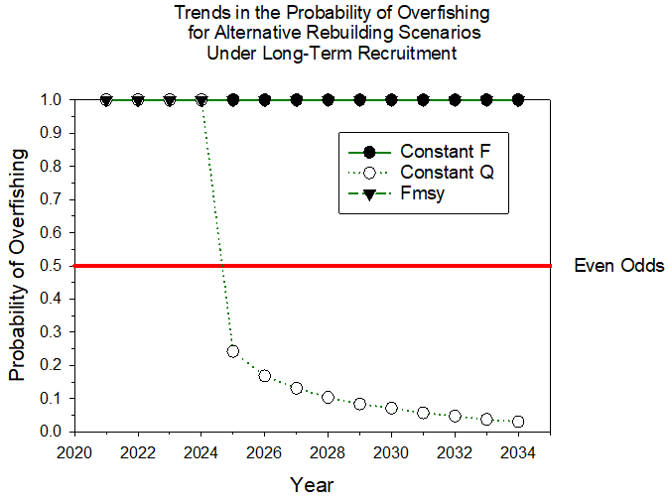
Long-Term Recruitment Results

Slide 73

~ Thanks and Mahalo !
Notes:
Thanks and Mahalo!

Slide 74
Auxiliary Slides

Slide 75
Residual Patterns for Recruitment

Slide 76
Residual Patterns for Recruitment

Slide 77
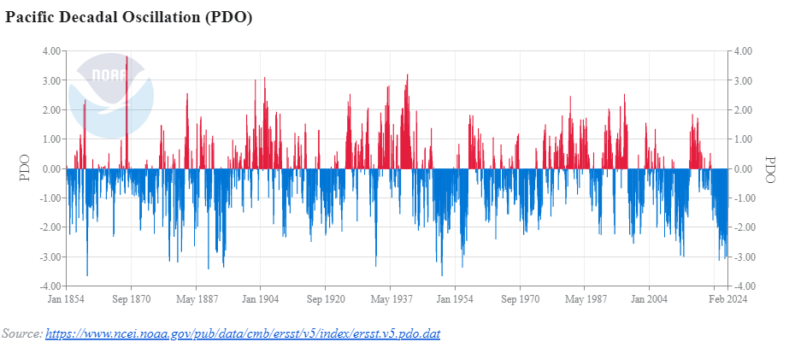
PDO: Medium-Term Environmental Forcing
August 1998

Slide 78
Temporal Change in WCNPO Striped Marlin Recruitment

Slide 79
Estimating When the Change Occurred

Slide 80
Recruitment: Estimating When the Change Occurred
Τ=1993

Slide 81
Spawning Stock Biomass: Change Points
Τ₁=1978
Τ₂=1995

Slide 82
Summarize Time Series Results
Recruitment: Nonstationary with probable AR(1) or MA(1+) processes
Spawning Biomass: Nonstationary with probable AR(1) or MA(1+) processes
Recruits Per Spawner: none
ONI: Nonstationary with probable negative serial correlation at lag 2
MEI: Same as ONI but shorter time series
PDO: Nonstationary with probable AR(1) or MA(1) processes
Source: 2024-Feb-6.pptx on https://github.com/PIFSCstockassessments/2024-WCNPO-MLS-Rebuilding

Slide 83
Preliminary Recruitment Models for Projections
Short-term recruitment (5-year ECDF): Random sampling from the Empirical Cumulative Distribution Function of Recruitment during 2016-2020
Working hypothesis is that recruitment in the next 10 years will be similar to that observed in the recent past, with a period of about 1 mean generation time (5 years)
Similar to short-term recruitment model used in 2020-2021 WCNPO Striped Marlin rebuilding plan analyses
Mean(Recruitment) = 163.0 (age-1, 000s)
CV(Recruitment) = 33%

Slide 84
Preliminary Recruitment Models for Projections
Medium-term recruitment (20-year ECDF): Random sampling from the Empirical Cumulative Distribution Function of Recruitment during 2001-2020
Working hypothesis is that recruitment in the next 10 years will be similar to that observed in the past 2 decades, with a period of about 4 mean generation times
Matches the time window used to calculate the dynamic unfished Spawning Stock Biomass for the WCNPO Striped Marlin F20% reference points. Matches recommendation for additional recruitment hypothesis from the WPRFMC’s Scientific and Statistical Committee
Mean(Recruitment) = 171.6 (age-1, 000s)
CV(Recruitment) = 45%

Slide 85
Preliminary Recruitment Models for Projections
Long-term recruitment (Beverton-Holt Curve Fitted in Base Case Assessment Model): Random sampling from the expected stock-recruitment curve with lognormal error
Working hypothesis is that recruitment in the next 10 years will be similar to that observed over the assessment time period of 1977-2020
Long-term recruitment model assumes stationarity of recruitment dynamics in 1977-2020
Modified Beverton-Holt parameters: h = 0.87, R₀ = 405.8, SSB₀ = 19278.8, σ_{R} = 0.6
Mean(Predicted Recruitment) = 301.3 (age-1, 000s)
CV(Predicted Recruitment) = 14%

Slide 86
Set Recruitment Model Weights
Use a Tactical Approach (Dormann et al. 2018) Based on Predictive Accuracy
Use out-of-sample predictions for most recent observed recruitments in 2020-2021 (age-1)
Use 5-year ECDF from 2015-2019 for short-term prediction algorithm
Use 20-year ECDF from 2002-2019 for medium-term prediction algorithm
Use expected recruitment from fitted Beverton-Holt curve for long-term prediction

Slide 87
Recruitment Predictions for Age-1 in 2020 and 2021 to Calculate Mean Squared Error and Inverse Variance Weights for each Recruitment Model

Slide 88
Recruitment Predictions for Age-1 in 2020 and 2021 to Calculate Mean Squared Error and Inverse Variance Weights for each Recruitment Model

Slide 89
Results of Reweighting Based on the Estimated Standard Error of the Point Estimate of Recruitment: Calculate Weights for 2020-2021 Based on Variance of Recruitment

Slide 90
Results of Reweighting Based on the Estimated Standard Error of the Point Estimate of Recruitment: Combining the Annual Weights with the Inverse Variance Predictive Accuracy Weights

